Slide 1
Practice #3
Create Performance Task

Slide 2
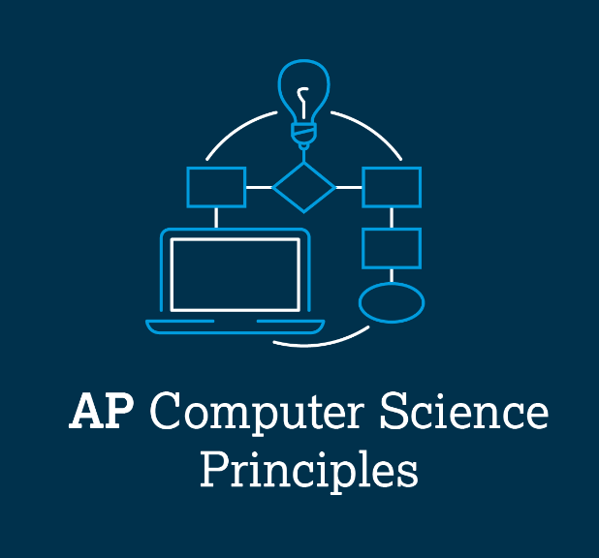
AP CSP Create Performance Task
Part of the AP Exam is to create a program that meets specific requirements:
Creates a list
Uses a list in a meaningful way
Has a function with a parameter
  Parameter affects function execution
Function has:
  If statement
  Loop

Slide 3
AP CSP Create Performance Task
Things to know about the Create PT:
You can work with a partner
Your classmates can help you
Your teacher cannot help you
You cannot use an assigned program for your project, but it can be similar
You will be given 9 hours of class time to work on the project

Slide 4
AP CSP Create Performance Task
The Create PT is like a remix project:
Start small and add components.
Start with what you know.
Don’t try something new that you don’t know how to do.
This isn’t a time to learn something new, but to show what you know how to do.

Slide 5
AP CSP Create Performance Task
The Create PT is like a remix project:
During a remix, you looked at completed programs and reviewed what you learned.
You either added to or created a program similar to your completed programs.
You can do the same thing for the Create PT.
Let’s look at a program from a mission and remix it to meet the requirements of the Create PT.

Slide 6
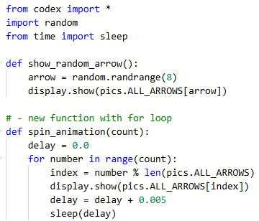
Practice #3
In CodeSpace, go to the Sandbox.
Open the project: Game_Spinner_traversal
What PT requirements does it meet?
What PT requirements does it lack?

Slide 7


Practice #3
PT Requirements
Creates a list
Uses a list in a meaningful way
Has a function with a parameter
  Parameter affects function execution
Function has:
  If statement
  Loop

Slide 8
Practice #3
This project meets most of the requirements, but it doesn’t create its own list.
You could create an arrow list, but there are still more requirements to fulfill.
For this remix, let’s create a similar program.
The function of the program is to randomly select a student in a class.

Slide 9
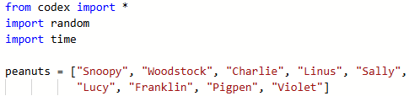
Practice #3
In CodeSpace, start a New File and name it PT_Practice3
Import the modules you will need for the program
Create a list of students in this class

Slide 10
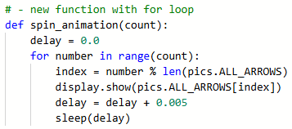
Practice #3
Create a function similar to the game_spinner function, but use the student list you created.
Traverse the loop to access the elements in the matrix.
Try doing this function on your own.

Slide 11
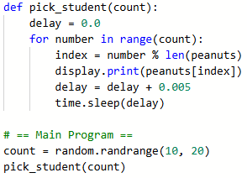

Practice #3
Add a main program to call the function, and run the code.
It works pretty well, but it can be better.
Make the text bigger
Clear the screen before each name is displayed.

Slide 12
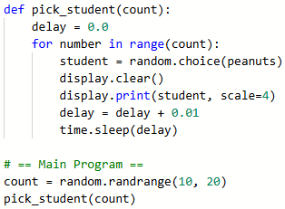
Practice #3
Run the code again.
Make any of your own adjustments.
You can keep the loop traversing the list, or you can change it to select a random student.

Slide 13
Practice #3
Revisit the PT Requirements:
Creates a list
Uses a list in a meaningful way
Has a function with a parameter
  Parameter affects function execution
Function has:
  If statement
  Loop

Slide 14
Practice #3
Open PT_Practice1
Review the function with a parameter, and how it used the parameter in an if statement.
The program uses two lists.
Your current remix can also use two lists!

Slide 15
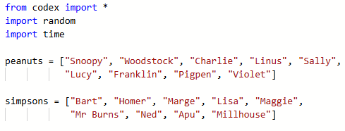
Practice #3
Add a second list of students, from a different class period.

Slide 16
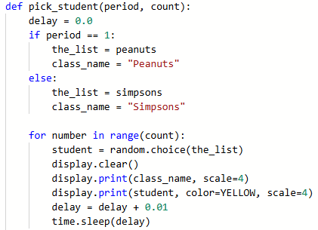
Practice #3
Add another parameter to the function, for the class period.
Use the parameter in an if statement to assign the list.
Use the local variables in the for loop.

Slide 17
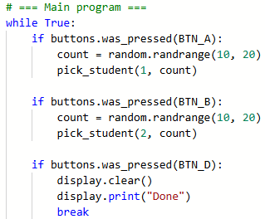
Practice #3
Look the PT_Practice1 again.
Review the main program, and the if statements for button presses.
Complete the main program.

Slide 18
Practice #3
Revisit the PT Requirements:
Creates a list
Uses a list in a meaningful way
Has a function with a parameter
  Parameter affects function execution
Function has:
  If statement
  Loop

Slide 19
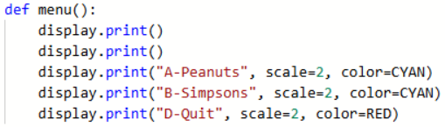
Practice #3
Last step: Code a function that gives instructions.
This program will really benefit from having an intro or instructions so the user knows what buttons to press.
You can code the intro function any way you want. An example is shown:

Slide 20
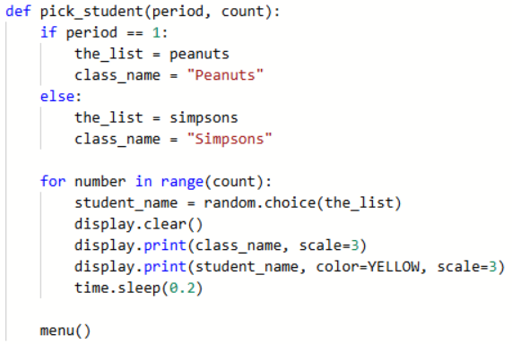
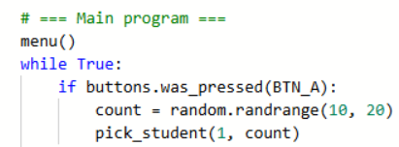
Practice #3
Last step: Code a function that gives instructions.
Call the function whenever you want instructions displayed.
For example:
  In the main program, before the infinite loop
  In the pick_student() function

Slide 21
Practice #3
Now that you have seen an example of a remix from the Game Spinner program, can you think of any other ways to remix the project for the Create PT?
Go to the Activity Guide and write down any more ideas you have for modifications.

Slide 22
Practice #3
Final considerations.
Your program needs to have input and output.
  Be prepared to explain the input and output of this program.
  This program has input through button presses.
  In a video, you want to show the button presses, or add a caption that explains how the video shows input
  The output is the name on the screen.
  In a video, you want to show clear text on the screen.

Slide 23
Practice #3
Final considerations.
Your program needs to have a specific purpose and intended user.
  The purpose of this program could be explained as an educational and equitable tool for the classroom.
  The function is to select a random student from a list.
  The intended user is an educator, such as a teacher or support, or even another student, who wants to equitably choose a student.

